Slide 1
Data Compression with Deep Autoencoders
George Dialektakis
Evaluation exercise for Google Summer of Code / ATLAS autoencoders

Slide 2
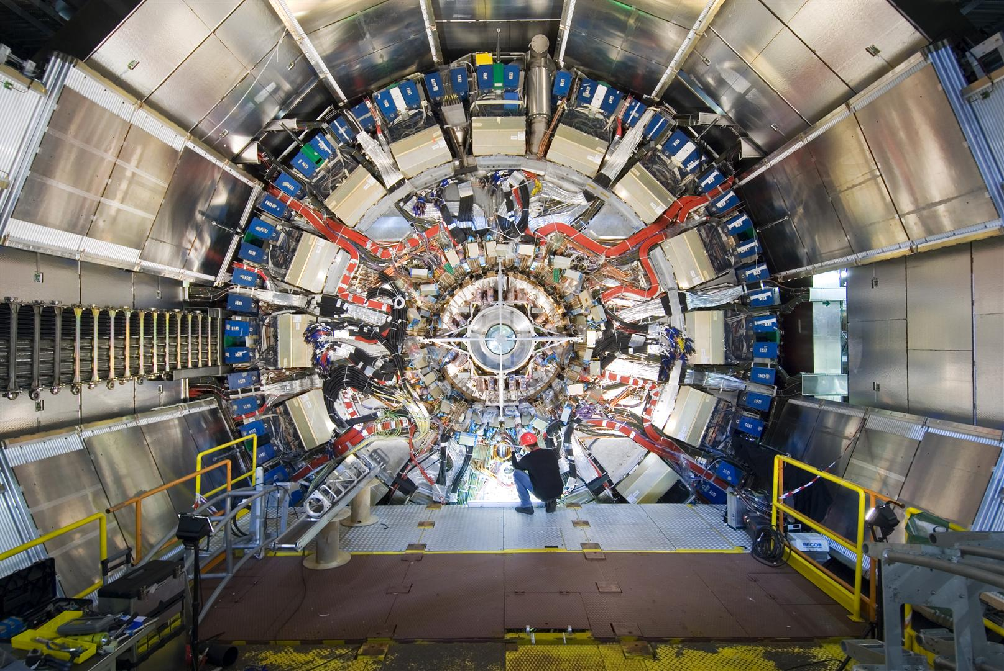
Motivation
At CERN’s Large Hadron Collider (LHC), proton collisions are performed to examine the fundamental particles and their interactions.
The ATLAS detector is a general purpose detector at the LHC, used to detect and record the outcome of these collisions.
Every second, ATLAS is handling 1.7 billions events or collisions, which occupy huge volume of storage, restricting the amount of information that can be recorded from the events.
Τhe ATLAS experiment uses trigger systems to filter out irrelevant information by picking and sending only interesting events to the data storage system.
A reduction of the event size can allow for explorations that were not previously possible due to the limited storage.
The ATLAS Detector

Slide 3
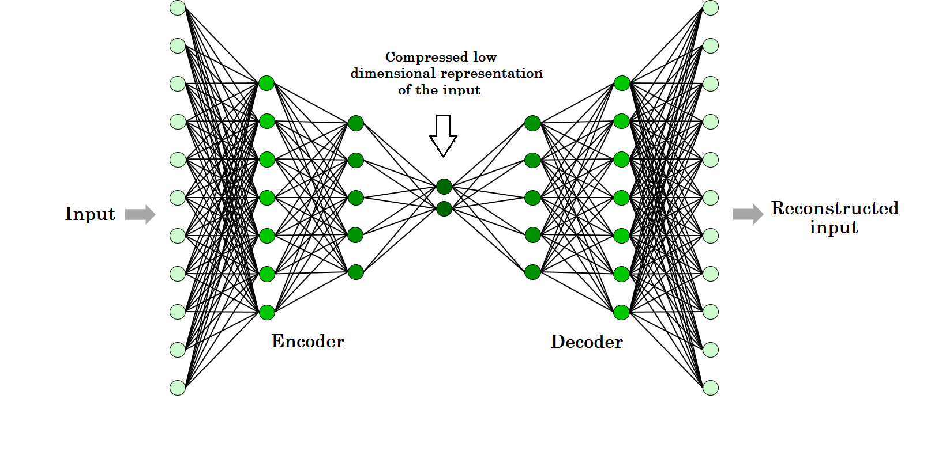
Data Compression
This project aims to investigate the use of autoencoders (AEs) to compress event-level data generated by the HEP detector.
In specific, an AE is used to compress the “four-momentum” of jet particles from 4 to 3 variables.
An AE is a neural network that tries to implement an approximation of the identity function.
It consists of an Encoder, a latent space, and a Decoder.
The goal is to learn the distribution of the “four-momentum” of jet particles by projecting them to a 3-dimensional space and then reprojecting it back to 4.
The latent space can then be used as a compressed representation of the input.
A common Autoencoder Network

Slide 4
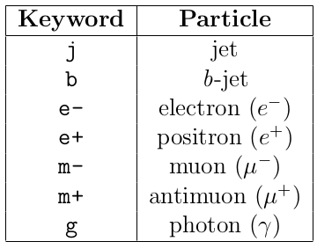

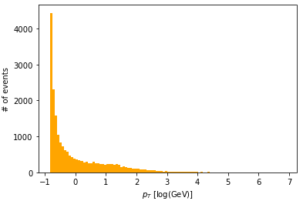
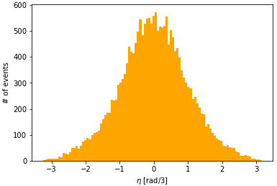
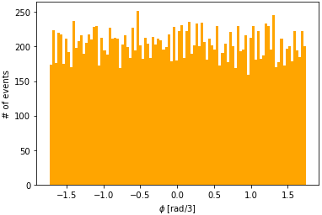
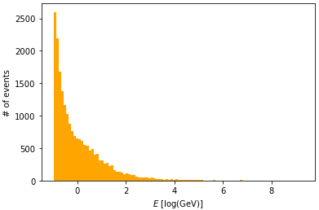
Data preparation
First we apply some data preprocessing on the initial given dataset which has the following format:
In specific, we filter out the unnecessary information in 2 steps:
Remove event ID, process ID, event weight, MET, METphi
We keep only the jet (j) particles, and discard the rest as shown in the image on the right
Then, we normalize the by removing the mean and scaling to unit variance as follows:
where x is the 4-dimensional data containing the parameters E, pt, eta, phi
Distribution of our data

Slide 5

Experiments - Setup
We considered two AE variants with 7 fully-connected layers:
200-200-20-3-20-200-200 neurons
100, 50, 10, 3, 10, 50, 100 neurons
Hardware for computation:
Intel Core i5 4690 @ 3.50GHz, 8 cores
16 GB RAM DDR3
And two different activation functions after each layer:
Tanh
LeakyRelu
Data size:
Train : 16292 samples
Test: 4073 samples
We split the data into train (80%) and test (20%) set.
We train the AE using the Mean squared error (MSE) as the optimization loss function, as we want the decompressed 4D data should be same as the input data:

Slide 6
Experiments - Results
Evaluation on test set
In total, 4 models applied:
Big AE: 200-200-20-3-20-200-200, with tanh
Big AE: 200-200-20-3-20-200-200, with LeakyRelu
Small AE: 100-50-10-3-10-50-100, with tanh
Small AE: 100-50-10-3-10-50-100, with LeakyRelu
Model | MSE | Execution Time (s)
Big AE - Tanh | 0.000081 | 87.75
Big AE - LeakyRelu | 0.000040 | 98.98
Small AE - Tanh | 0.000084 | 73.80
Small AE - LeakyRelu | 0.000064 | 81.94
Train over 100 epochs.
Learning rate with the steepest gradient.
Observations:
The autoencoders that use the LeakyRelu achieve lower reconstruction error.
However, their training is more time consuming than those applying the tanh.
We observe that the big models, with the most neurons, perform the best in terms of MSE, but they require more training time.

Slide 7
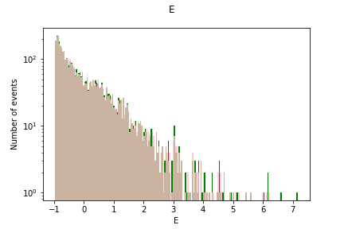
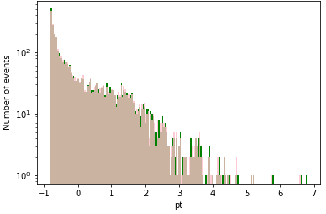

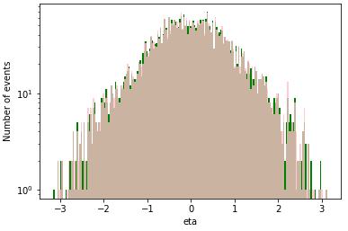
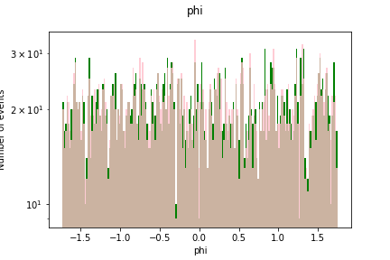
Experiments - Results
Plots of the compressed representation for each variable generated by the AE vs their real value
For the sake of brevity, we present only the plots that correspond to the 200-200-20-3-20-200-200 model using the LeakyRelu activation function.
We observe that the model can construct robust and accurate compressed representations which are very close to the input values
Code: https://github.com/gdialektakis/Deep-autoencoders-for-ATLAS-data-compression

